Slide 1











Kineret Ruth Nahary
206903684
Dvir Barzilay
318751971

Slide 2
About The System
The app main focus is to develop a place where users can record every cherished moment into their own personal diary, and remember it for the rest of their lives.
All their memories will be within reach in the application that acts as their personal diary, so that they can view and add new memories at any given moment.

Slide 3

Registration To The App:

Slide 4
The use of Google Cloud Platform as a whole, and the use of Cloud Vision API in particular, have enabled us to use a well-trained learning machine by Google to identify objects and elements that appear in the image that has been uploaded to a memory in the user’s diary.
Identifying image content is a necessary and central component for implementing an advanced search in an app.
Advanced Search is measured in its ability to produce relevant results for a search query. This ability is endowed with identifying keywords that are relevant to a particular memory, even if not necessarily written in it.

Slide 5
Algolia helps to create relevant, scalable, and lightning-fast search and discovery experiences.
With Algolia we were able to build a Custom Search Engine for our needs.
For each memory created, edited, or deleted, we had to update the appropriate index in the search engine, so that the search engine will remain reliable and will produce results as correct and relevant as possible.

Slide 6
We have chosen to use Firebase platform as a database for all of the app’s users, for the purpose of backing up the information and for the authentication process.
The use of Firebase has helped us to recover users lost information, as a result of accidently deleting the app or switching to a new phone.

Slide 7
In order to produce an up-to-date search engine, we had to listen to the events of adding new memory to the user’s diary, editing existing memories or deleting memories from Firebase.
For that, we have written a server side code in JavaScript that listens to the database changes made in Firebase Cloud Storage.
When a create / edit or delete event occurs, the JavaScript code on the server side arises and interfaces with Algolia, to update the search engine with the relevant changes.

Slide 8
Main Feature : Advanced Search
In this app, we have implemented an advanced user search engine where it can search for memories that have been logged in the diary.
The search we used was smart enough to show results for a query based on the photo that was attached to the memory.
The user can also search for memories based on the keywords he wrote in the experience description, and the date the memory was created.

Slide 9
Main Feature : Advanced Search
The implementation of the advanced search is made up of two main steps:
Memory Indexing - Performs while creating, editing, or deleting memory.
Running query and displaying the results.
Notes:
כאשר זיכרון חדש נוצר, האפליקציה ניגשת ל GCP - Google Cloud Platform כדי להשתמש ב Cloud Vision API לצורך שימוש במכונה שאומנה על ידי גוגל למציאת Labels בתמונה.
כאשר האפליקציה מקבלת בחזרה רשימה של Labels שנמצאו בתמונה, האפליקציה תעלה לFirebase את כל הנתונים שהמשתמש הזין על הזיכרון, ביחד עם רשימת ה Labels.

Slide 10
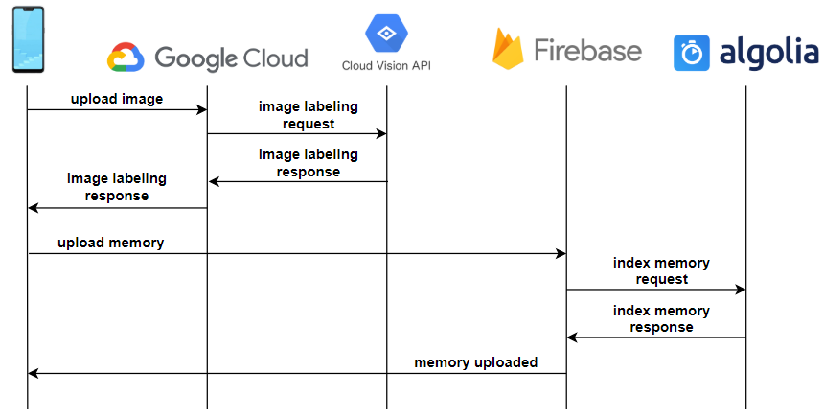
Memory Indexing : Create Memory Sequence Diagram

Slide 11
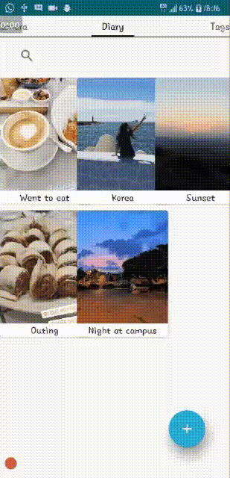
Creating Memory & Adding To Diary

Slide 12
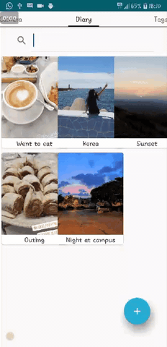
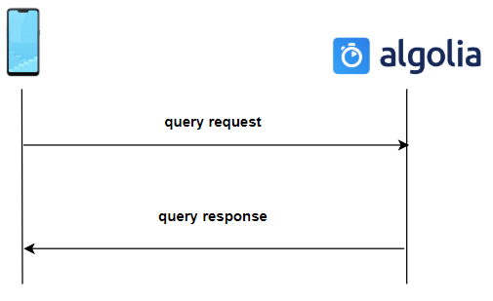
Sequence Diagram : Execute Search

Slide 13
Implementation of the Advanced Search Feature
Most of this feature implemented in Kotlin language. Kotlin is a modern and innovative language designed to run on JVM and specifically developed for Android app development.
We have chosen to learn to develop in Kotlin language to experiment with another programming language besides Java, a language we have not learned before, and to gain experience in an ever-evolving language that is becoming increasingly popular in Android application development.
As well, the code responsible for listening to the changes that are made in Firebase Cloud Storage, and updating accordingly Algolia we wrote with Node.js in JavaScript language.

Slide 14
Feature II - Backup in the Cloud
We see great value in providing the ability to backup and restore lost information, especially as it is sensitive information with great personal value. Today, for most advanced applications, such as Whatsapp, there is the option to backup and restore user personal information.
While designing the app, we chose to store all user memories in Firebase Cloud Storage rather than a local database on the user's device. We made this choice because we wanted to allow the user to recover lost information as a result of deleting the app or moving to a new phone.
In addition, storing the information in a cloud database will allow us to develop additional user interfaces in the future, which can also create, delete or edit existing memories through the browser, desktop application or any other interface.

Slide 15
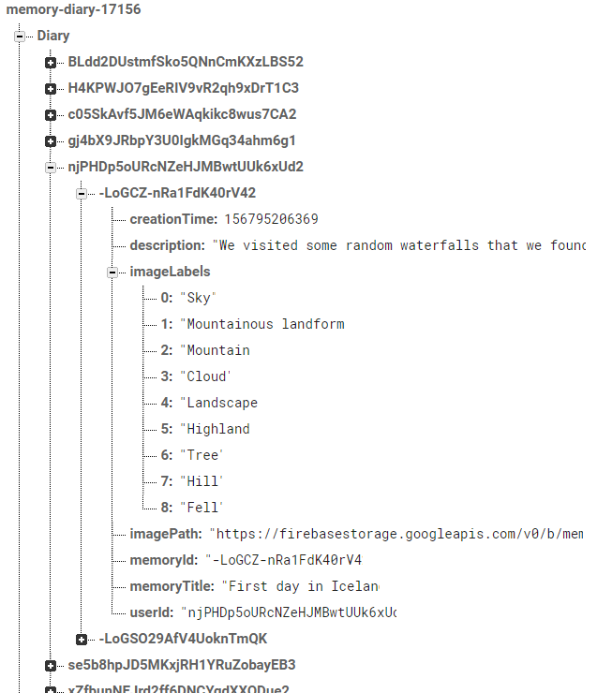
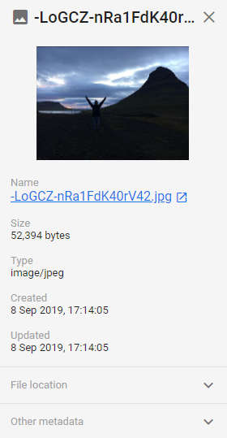

Slide 16
Feature III - Memory Tagging & Sharing
The application supports sharing a certain memory to a contact via phone number. The user can send a copy of a specific memory he has in his diary to an acquaintance of his, be it someone who had been with him and experienced the same things as him or else.
The acquaintance will receive a cloned version of the memory and will be able to choose between deleting it or accepting it. Upon acceptance, the memory will be added to his own diary without any connection to the original, so he could edit it as he have experienced it.

Slide 17
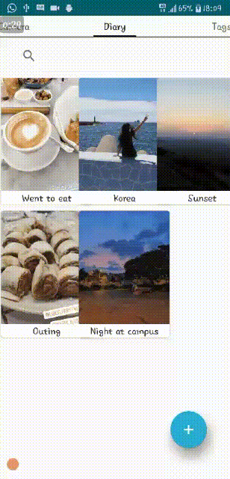
Tagging & Sharing
an acquaintance

Slide 18
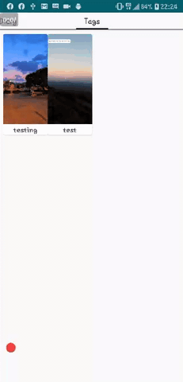
From the acquaintance side...

Slide 19
Feature IV - Smart Notifications System
Once the user first logged to the app, the system analyses once a week the amount of photos taken in a day and calculates the average.
Then, every time the user goes above average in a day, the system interprets it as a possible new memory to document and notifies him of it.
For example, the user goes out on a trip and takes more photos than usual with his phone, the system will notice this change and send a notification asking him if he wants to document something in his diary.

Slide 20
THE END…

